Slide 1
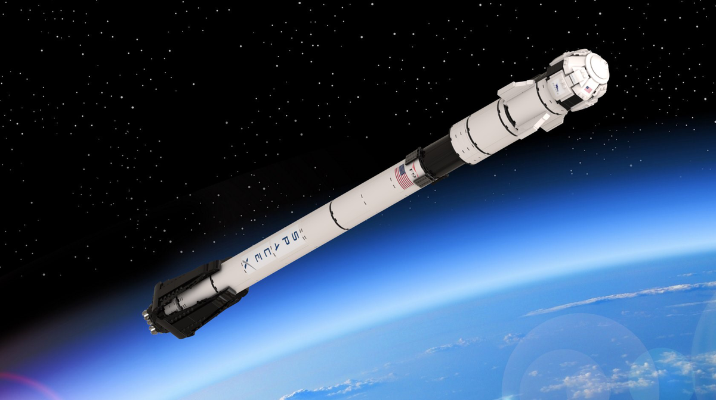

Winning Space Race
with Data Science
Felipe Maia
06-Apr-2022

Slide 2
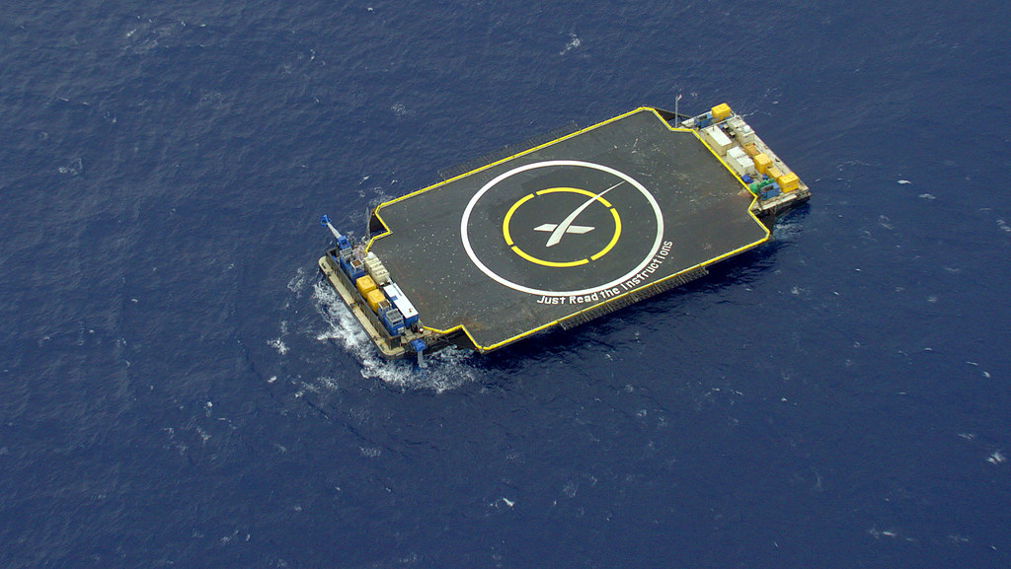
Outline
Executive Summary
Introduction
Methodology
Results
Conclusion
Appendix

Slide 3

Executive Summary
The following methodologies were used to analyze data:
Data Collection using Web Scraping from Wikipedia, SpaceX REST API and SQL;
Exploratory Data Analysis (EDA), including data wrangling, data visualization and interactive visual analytics like Dash, Folium and Seaborn Plots ;
Machine Learning Prediction.
Summary of all results
EDA allowed to identify which features are the best to predict success of launchings.
Interactive Analysis
Best Model for Predictive Analysis

Slide 4
Introduction
Project background and context:
The commercial space age is here, companies are making space travel affordable for everyone. There are major companies in segment, like Blue Origin, Virgin Galactic, and Space X. The current leader in this race seems to be the last one, and the reason behind that is the reusability of their first stage. Which reduces the cost of launch from a minimum of 165 million to around 62 million per launch.
The objective of this Project is to evaluate the viability of a new company to compete with Space X. So, we need to find the best way to estimate the total cost for launches, by predicting successful landings of the first stage of rockets and where is the best place to make launches.
So, the questions are:
What factors determine if the rocket will land successfully?
What is the interaction amongst various features that determine the rate of a successful landing?
Conditions which will aid SpaceX have to achieve the best results.

Slide 5
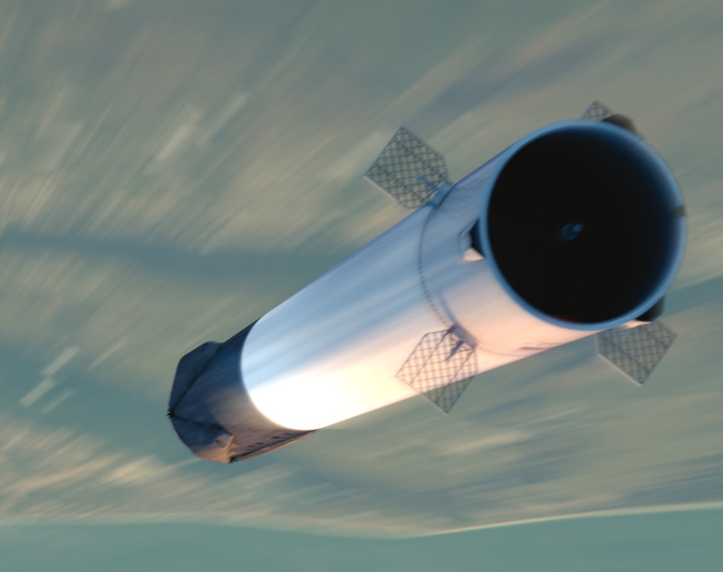
Section 1
Methodology

Slide 6
Methodology 1/2
Executive Summary
Data collection methodology:
SpaceX Rest API
Web Scrapping from Wikipedia
Perform data wrangling
Data cleaning of null values and irrelevant columns. One Hot Encoding for ML.
The Landing Pad column will retain None values to represent when landing pads were not used.
The mean and the replace() function was used to replace np.nan values in the data with the mean calculated.

Slide 7
Methodology 2/2
Executive Summary
Perform exploratory data analysis (EDA) using visualization and SQL
Perform interactive visual analytics using Folium and Plotly Dash
Perform predictive analysis using classification models
Data was normalized, splitted in Training and Test data sets, performed a GridSearchCV to find the best parameters and evaluated by four different classification models.
The models used was LR, KNN, SVM and Decision Tree to find the best classifier and the best accuracy.

Slide 8
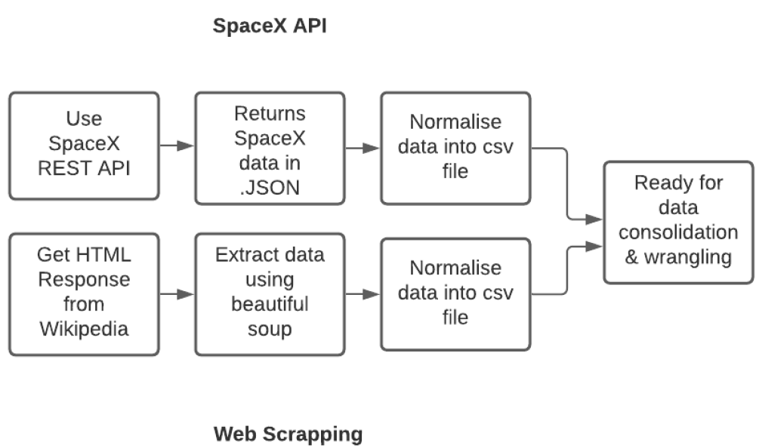
Data Collection
The following datasets was collected:
SpaceX Launch Data was obtained from the SpaceX REST API.
This API gave us data about the Launches, including information about the Rocket used, Payloads, Orbit, Core, launch specifications, landing specifications, and landing outcome.
The SpaceX REST API endpoints, or URL, starts with api.spacexdata.com/v4/
And data collected by Web Scraping method from Wikipedia using BeautifulSoup.

Slide 9
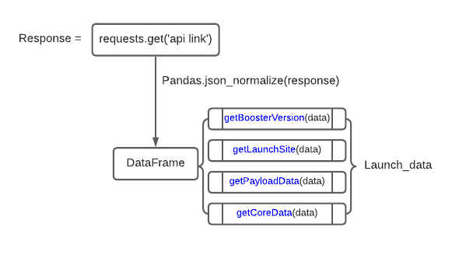
Data Collection – SpaceX API
Data collection with SpaceX REST calls using key phrases:
Request and parse the SpaceX launch data using the GET request.
Response content as a Json using .json() and turn it into a Pandas dataframe using json_normalize()
Using Dataframe into the created functions.
GitHub - Lab 1: Collecting the data

Slide 10
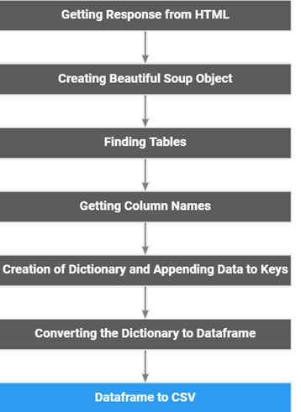
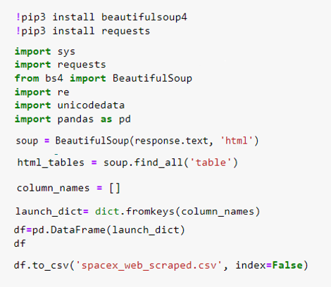
Data Collection – Web Scraping Method
GitHub - Lab 2: Web Scraping

Slide 11
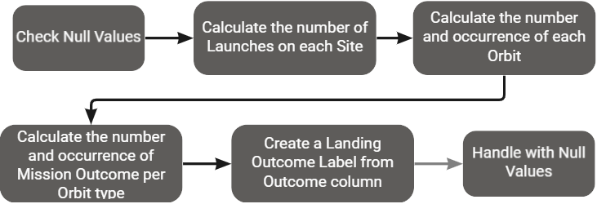
Data Wrangling
Initially, the data were filtered to contain only Falcon 9 records, then it was found that there were some null values in the dataset. The Landing Pad column will retain None values to represent when landing pads were not used. Null values in the column PayloadMass was replaced by the mean value. And One hot encoding was done for some categorical variables in order to feed them to the ML algorithm after performing feature scaling.
GitHub - Data Wrangling Lab

Slide 12
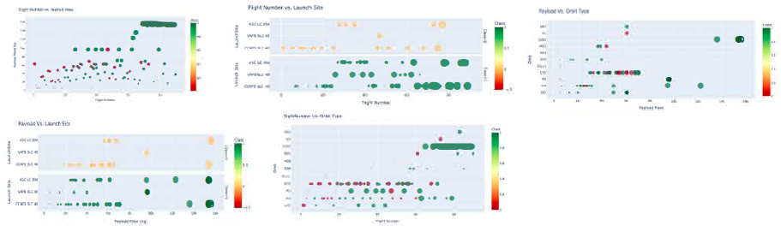


EDA with Data Visualization
Scatter Graphs
Payload and Flight Number
Flight Number and Launch Site
Payload and Launch Site
Flight Number and Orbit Type
Payload and Orbit Type
A scatter plot uses dots to represent values for two different numeric variables. The position of each dot on the horizontal and vertical axis indicates values for an individual data point. Scatter plots are used to observe relationships between variables.
Scatter
Line Graph
Launch Success Yearly Trend
A line chart is a way of plotting data points on a line. Often, it is used to show trend data, or the comparison of two data sets.
Line
Bar
Bar Graph
Success Rate VS. Orbit Type
A bar chart provides a way of showing data values represented as vertical bars. It is sometimes used to show trend data, and the comparison of multiple data sets side by side.
GitHub - Visualization Lab

Slide 13

EDA with SQL
SQL queries to get the Data:
Display the names of the unique launch sites in the space mission.
Display 5 records where launch sites begin with the string 'CCA’
Display the total payload mass carried by boosters launched by NASA (CRS)
Display average payload mass carried by booster version F9 v1.1
List the date when the first successful landing outcome in ground pad was achieved.
List the names of the boosters which have success in drone ship and have payload mass greater than 4000 but less than 6000
List the total number of successful and failure mission outcomes
List the names of the booster_versions which have carried the maximum payload mass.
List the failed landing_outcomes in drone ship, their booster versions, and launch site names for in year 2015
Rank the count of landing outcomes (such as Failure (drone ship) or Success (ground pad)) between the date 2010-06-04 and 2017-03-20, in descending order
GitHub - SQL Lab

Slide 14
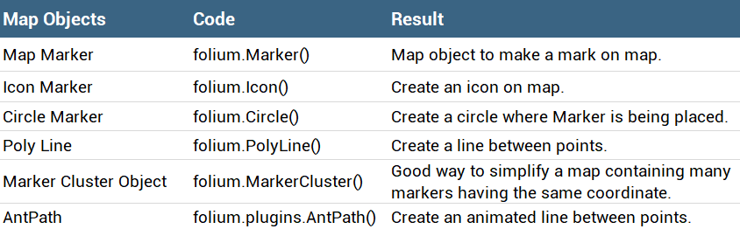
Build an Interactive Map with Folium
Folium makes it easy to visualize data that’s been manipulated in Python on an interactive leaflet map. It enables both the binding of data to a map for choropleth visualizations as well as passing rich vector/raster/HTML visualizations as markers on the map.
We use the latitude and longitude coordinates for each launch site and added a circle marker with a label around each launch site.
GitHub - FOLIUM Lab

Slide 15
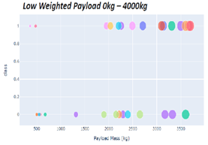
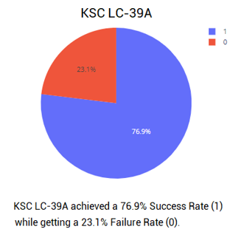
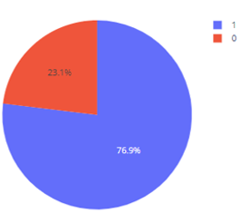
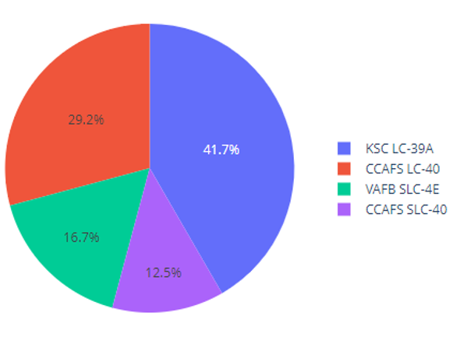
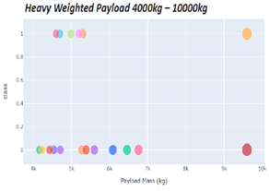
Build a Dashboard with Plotly Dash
Dash give a point-&-click interface to models written in Python, vastly expanding the notion of what's possible in a traditional "dashboard." With Dash we can cross data and visualize instantly and find the success of landings.
GitHub - DASH PLOTLY Lab

Slide 16
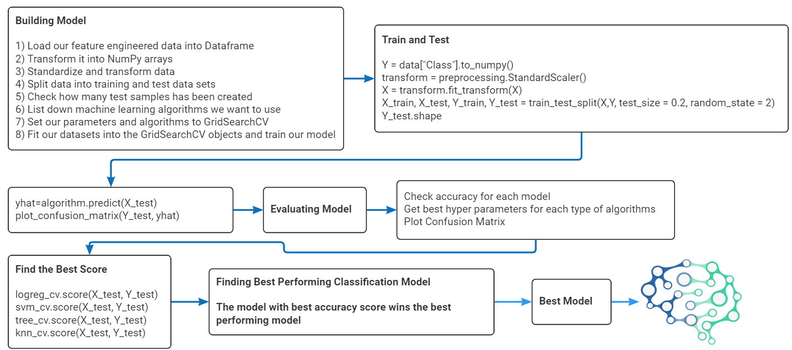
Predictive Analysis (Classification)
GitHub - ML Lab

Slide 17
Results
Exploratory data analysis results
Interactive analytics demo in screenshots
Predictive analysis results

Slide 18

Section 2

Slide 19
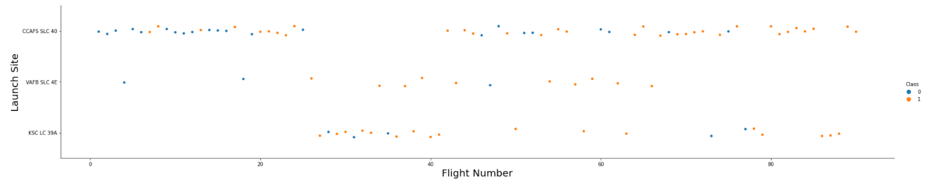

Flight Number vs. Launch Site

Slide 20
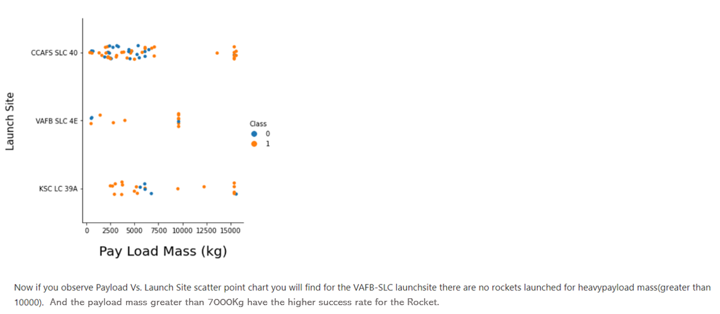
Payload vs. Launch Site

Slide 21
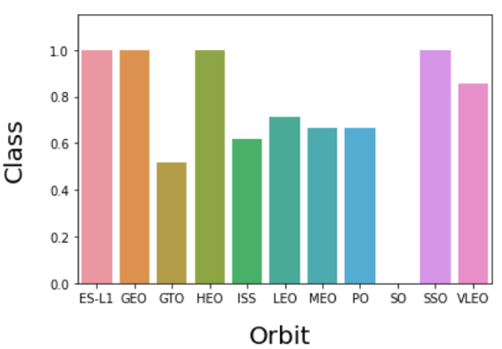
Success Rate vs. Orbit Type

Slide 22
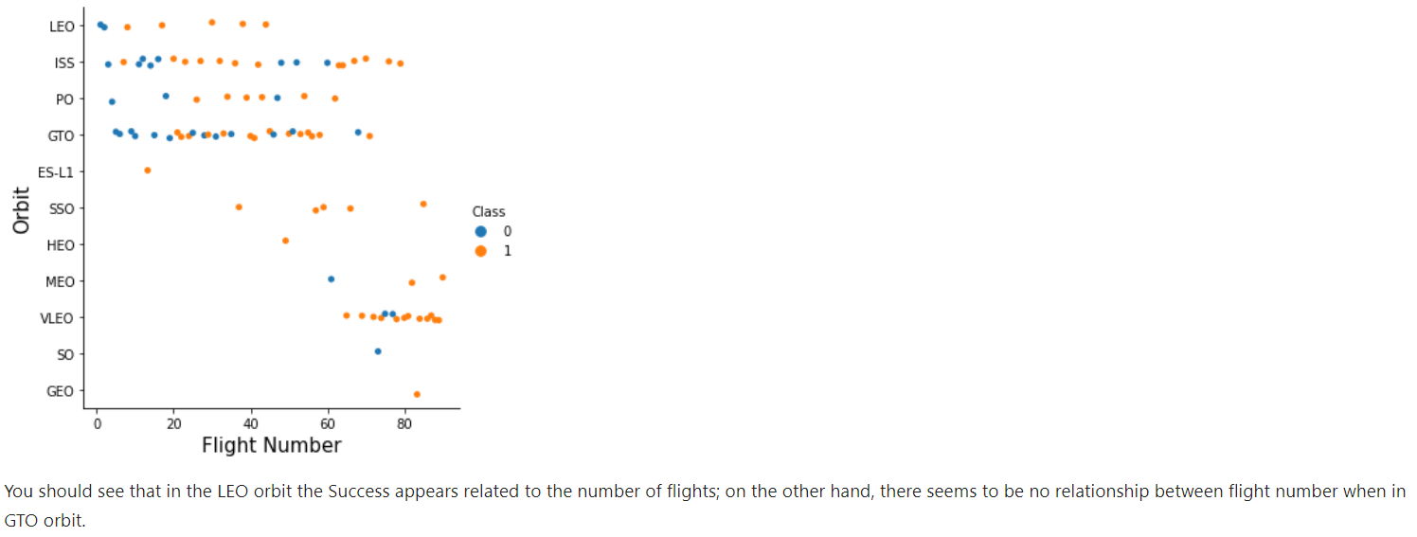
Flight Number vs. Orbit Type

Slide 23
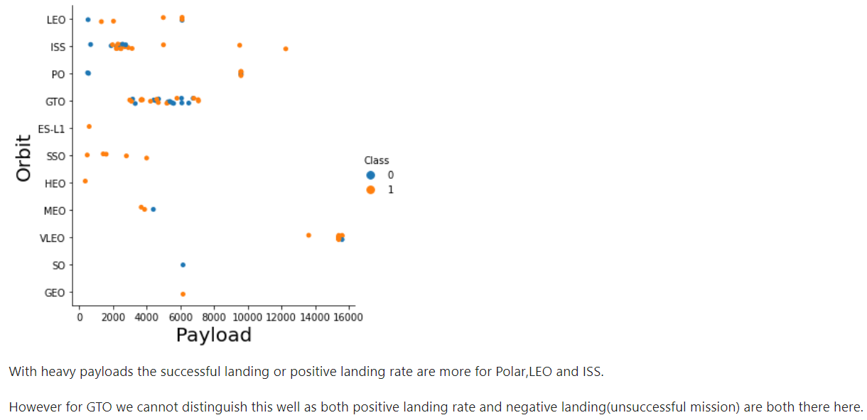
Payload vs. Orbit Type

Slide 24
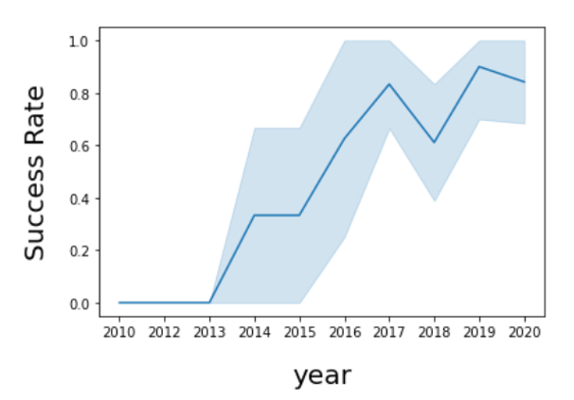
Launch Success Yearly Trend
The success rate increase since 2013 till 2020.

Slide 25
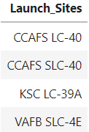
All Launch Site Names
The DISTINT statement is used to return only distinct (different) values. Inside the SpaceX table, the column Launch_Sites contained many duplicate values; and in our case we just want to list the different (distinct) values.

Slide 26
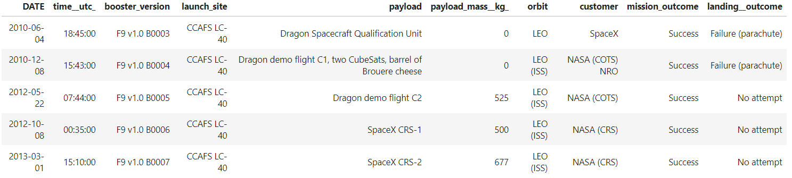
Launch Site Names Begin with 'CCA'
The SQL SELECT LIMIT statement is used to retrieve records from one or more tables in a database and limit the number of records returned based on a limit value. The LIKE command is used in a WHERE clause to search for a specified pattern in a column.

Slide 27
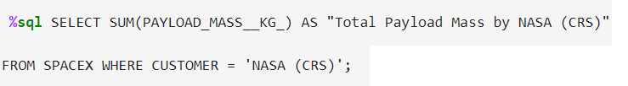
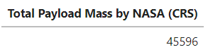
Total Payload Mass
The SUM() function returns the total sum of a numeric column.

Slide 28
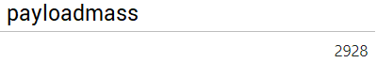
Average Payload Mass by F9 v1.1
The AVG statement calculates Average in the PAYLOAD_MASS_KG_ column.

Slide 29
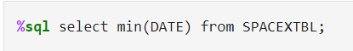

First Successful Ground Landing Date
The MIN() function returns the smallest value of the selected column. In our case, the DATE column.

Slide 30
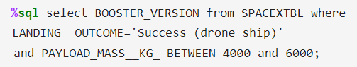
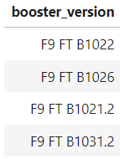
Successful Drone Ship Landing with Payload
between 4000 and 6000
Using WHERE with AND statement we can expand the power of the filter associating with a condition. Using the BETWEEN statement we can indicate a specific range to the filter.

Slide 31
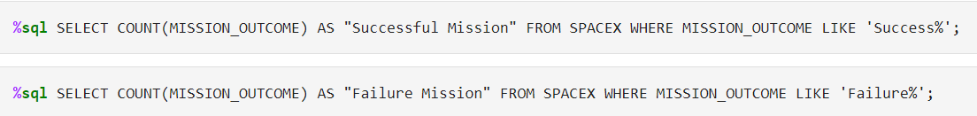
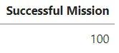
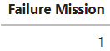
Total Number of Successful and Failure Mission Outcomes
The COUNT() function returns the number of rows that matches a specified criterion. Using the LIKE statement, we can filter every letters in quotes “ “ .

Slide 32
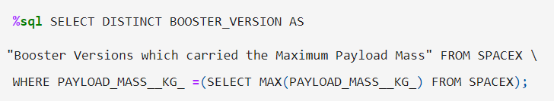
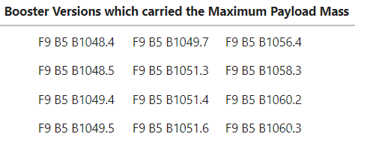
Boosters Carried Maximum Payload
The DISTINT statement is used to return only distinct (different) values (BOOSTER VERSION column).
We use the WHERE statement associating with MAX statement to figure out the maximum payload value in the PAYLOAD_MASS_KG_ column. In this case we had used a subquery to improve the filter.

Slide 33
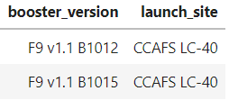
2015 Launch Records
We used a combinations of the WHERE clause, LIKE + AND conditions to filter for failed landing outcomes in drone ship, their booster versions, and launch site names for year 2015.

Slide 34
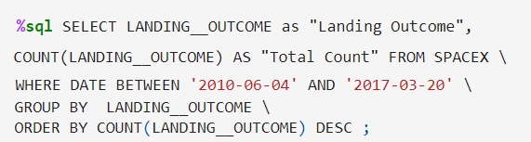
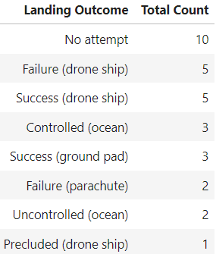
Rank Landing Outcomes Between 2010-06-04 and 2017-03-20
We selected Landing outcomes and the COUNT of landing outcomes from the data and used the WHERE clause to filter for landing outcomes BETWEEN 2010-06-04 to 2010-03-20.
We applied the GROUP BY clause to group the landing outcomes and the ORDER BY clause to order the grouped landing outcome in descending order.

Slide 35
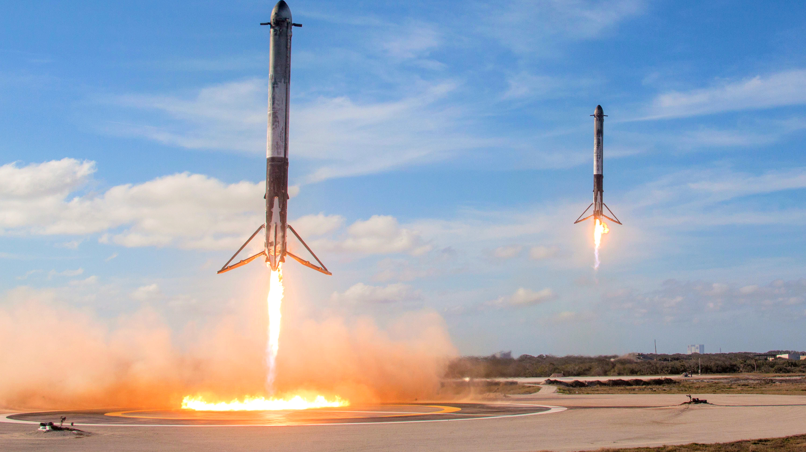
Section 3
Launch Sites
Proximities Analysys

Slide 36
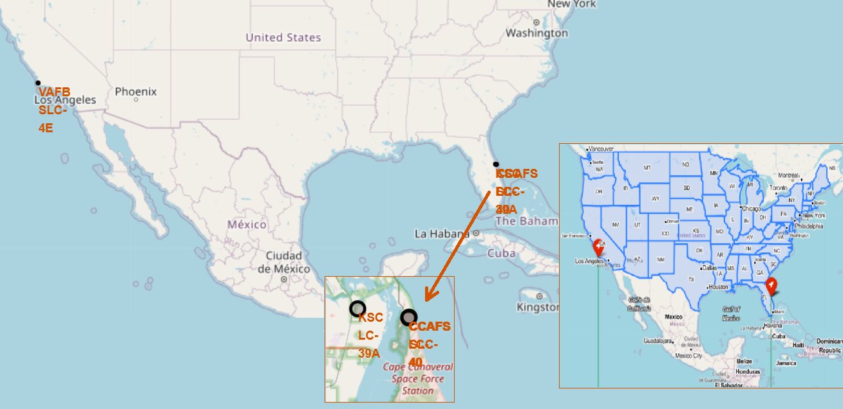
AII Launch Sites on Folium Map
We can see that the SpaceX launch sites are near to the United States of America coasts i.e., Florida and California Regions.

Slide 37
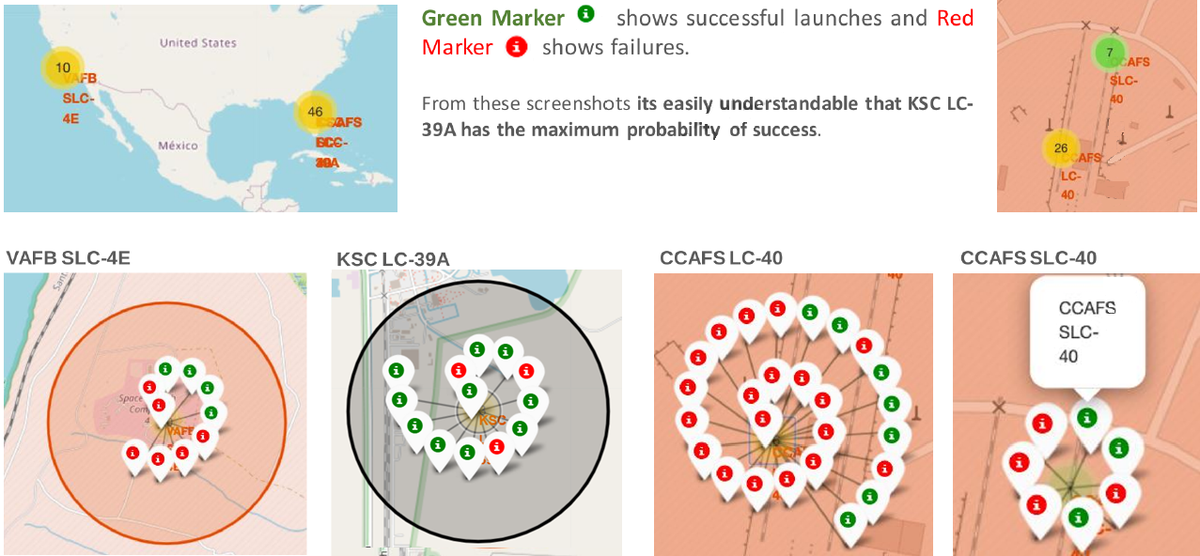
Color Labeled Launch Records

Slide 38
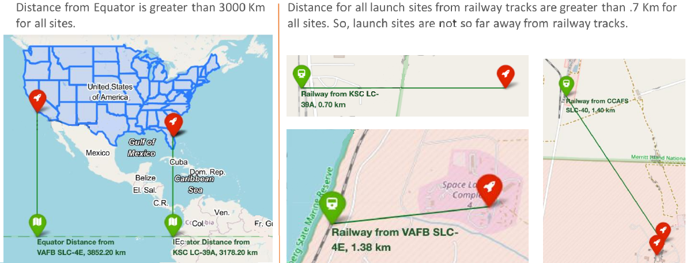
Launch Site Distances from Equator & Railways

Slide 39
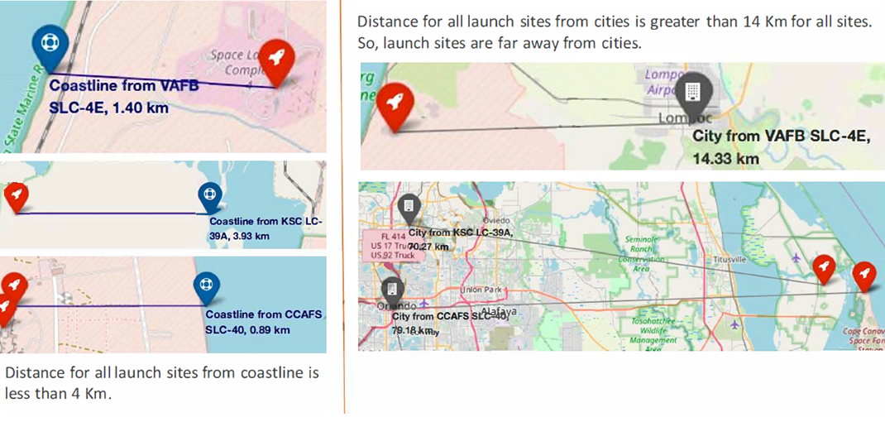
Launch Site Distances from Coastlines & Cities

Slide 40
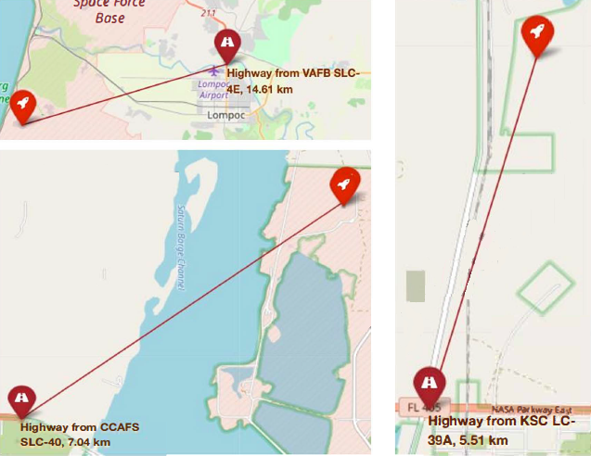
Launch Site Distances from Highways
Distance for all launch sites from highways is greater than 5 Km for all sites. So, launch sites are relatively far away from highways.

Slide 41
Launch Site Distances Resume
Distance for all launch sites from highways is greater than 5 Km for all sites. So, launch sites are relatively far away from highways.
The launch sites keep certain distance away from Cities (15 Km> distance > 80 Km).
There is no launch sites in proximity to the Equator Line. (4000 Km> distance > 3000 Km).
There is no launch sites in close proximity to Highways (15 Km> distance > 5 Km).
There is launch sites in close proximity to Coastline (5 Km> distance > 5 Km).
There is launch sites in close proximity to Railways. (2 Km> distance >5 Km).

Slide 42

Section 4
Building a Dashboard
with Plotly Dash

Slide 43

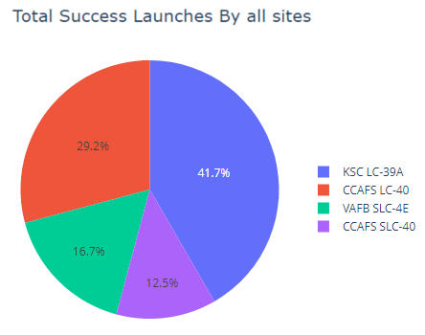
Launch Success for AII Sites
We can see that KSC LC-39A had the most successful launches from all the sites.

Slide 44
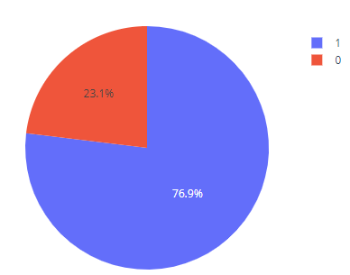
Launch Site with Highest Launch Success Ratio
KSC LC-39A achieved a 76.9% success rate (1) while getting a 23.1% failure rate (0).

Slide 45
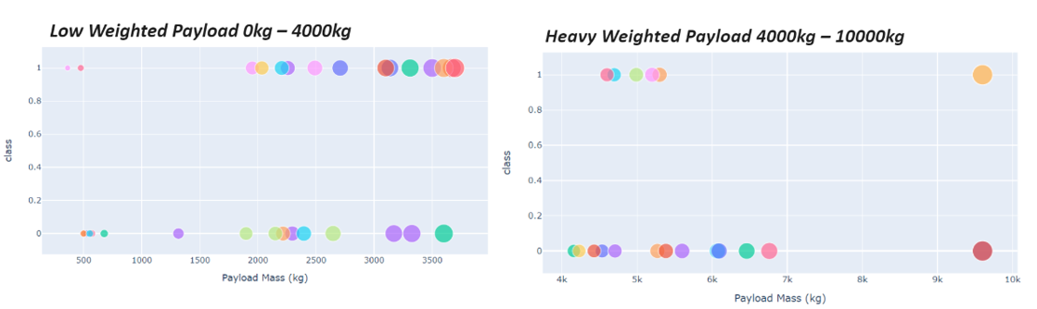
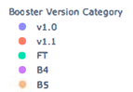
Payload vs. Launch Outcome Scatter Plot for AII Sites
The success rates for low weighted payloads is higher than the heavy weighted payloads.

Slide 46

Section 5
Predictive Analysis
(Classification)

Slide 47
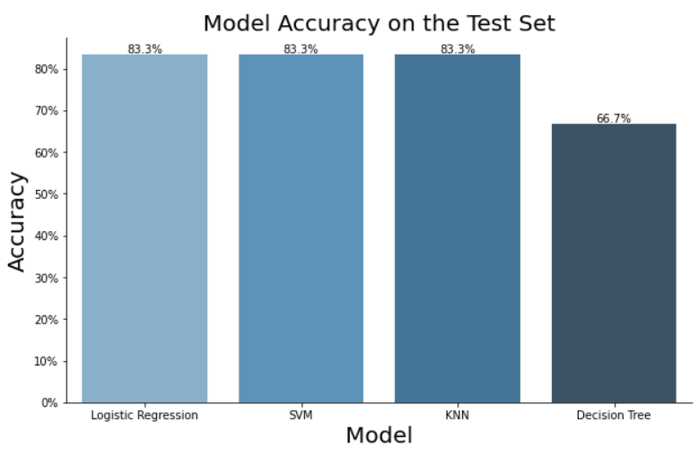
Classification Accuracy
Four machine learning models were used. The Logistic Regression, SVM and KNN models has the highest classification accuracy, 83.3%. The Decision Tree model has the lower, 66,7%.

Slide 48
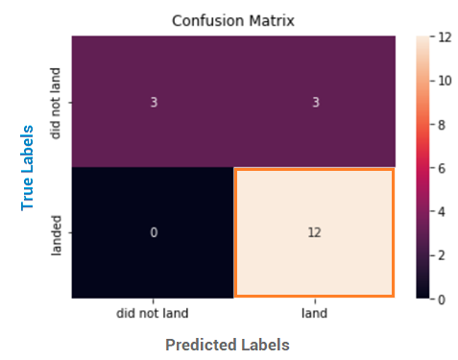

Confusion Matrix
The Logistic Regression, SVM and KNN models has the same Confusion Matrix. The “landed” x “land” block (True Positive =12 ) shows the landings success.

Slide 49
Conclusions
We had pursuit what factors determine if the rocket will land successfully, what features impact the rate of successful landing and the conditions which will aid SpaceX have to achieve the best results. So, the data show us that:
The best Orbits are: ES-Ll, GEO, HEO, SSO.
KSC LC-39A is best place to make launches, with 76.9% success rate .
Low weighted payloads perform better than the heavier payloads. However, in the CCAFS SLC 40 Launch Site the payload mass greater than 7000Kg have the higher success rate for the Rocket.
LR, SVM and KNN Algorithms are the best Machine Learning Models for provided Dataset.
Success rates for SpaceX launches has been increasing with Time. Considering that there are variables that significantly alter the landing success rate, it is possible to say that it is a matter of time for Space X to reach an incredible level of performance and precision.

Slide 50

Appendix

Slide 51

Appendix
Falcon Models

Slide 52

Appendix
Wikipedia Web Scraping

Slide 53

Appendix
Data Wrangling Session

Slide 54

Appendix
Proximities

Slide 55

Appendix
Proximities

Slide 56

Appendix
SQL query successful and failure mission outcomes.

Slide 57

Appendix
SQL query successful and failure mission outcomes.

Slide 58

Thank you!

